Slide 1
Binary Trees
CS2050 – Algorithm Design and Programming II

Slide 2
Trees
Trees are one of the most important data structures in computer science
They come in many forms
They provide natural representations for many kids of data that occur in applications
They are very useful for solving a wide variety of algorithmic problems
Static vs. Dynamic
Some trees do not change shape while an algorithm runs (static)
Some trees change constantly as nodes (“leafs”/”branches”) are inserted or deleted
Game trees are used to find a solution to a problem A given node can represent a specific game situation and the branches moving away from that node could be possible choices that can be made in a given situation

Slide 3
Trees
Search trees are used to help search for prestored information that is often associated with “search keys”.
Each node may represent a test that is performed on the search key used
The outcome of the test may determine which branch to take in the tree
The binary search is especially effective on search trees in a sorted order

Slide 4
Terms
Family relationship – such as parents or children
A parent has at least one node branching from them
A parent can be both a child and a parent
Geometric relationships – such as left and right, or bottom and top
A tree can have a top or bottom
You can “traverse” or move through a tree by moving left or right toward the bottom
Biological relationships – roots, branches, leaves
The “root” node is typically the top node in the tree. But a tree can contain subtrees
Branches come out from the root and have leaves
Leaves are nodes that have no children

Slide 5
Binary Tree
A binary tree is one in which each node has eactly two children.
Either or both of these children is permitted to be empty
If a node has two empty children, it is said to be a leaf
Recursion is used very heavily in binary tree algorithms
Inserting nodes
Deleting nodes
Searching the tree
Deleting the tree
Traversing the tree (inorder, preorder, postorder, etc.)

Slide 6
Searching ADT’s
Suppose we have implemented a linear Linked List. What is the best complexity we can achieve for a method that searches the list for a specified key?
O(N) – We have to compare the query key to the key in every node of the list.
Does the complexity change if we assume that the keys in the list are in sorted order?
No, the key to be found may be at the tail of the list.

Slide 7
Supporting Search Queries with Linked Lists
Why can’t the binary search algorithm be used with a sorted linked list?
How would we have to augment a sorted linked list to allow use of the binary search algorithm to find a specified key?
Or does binary search require keys to be stored in a sorted array?
Answer: No.

Slide 8
Binary Trees
A Binary Tree is a data structure that uses two pointers at each node:
In some cases the binary tree structure is used to represent the natural relationships that exist in a dataset. In most applications, however, there is information stored at each node that facilitates the efficient retrieval of other information stored in the tree.
KEY
LEFT
RIGHT

Slide 9
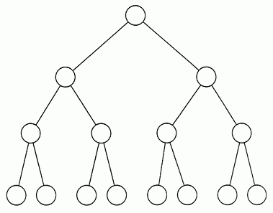
Binary Trees
The term “binary tree” derives from the branching that occurs when the two pointers are allowed to point to other than adjacent nodes:

Slide 10
Binary Search Trees
Nodes with keys that are Nodes with keys that are less than that of the node not less than that of the node
It is common to have the left pointer of each node point to nodes having key fields that are less than that of its key field and the right pointer point to ones that are not less than (greater-than-or-equal to) its key field.
A binary tree in which all nodes satisfy the above condition is referred to as a Binary Search Tree (BST).
KEY
LEFT
RIGHT

Slide 11
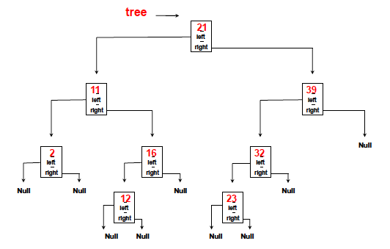
Binary Search Trees or BST
It can be verified that the keys in the below tree satisfy the BST condition, i.e., it is a BST:

Slide 12
BSTs vs. Linked Lists
The principle distinction between a linked list and a BST is that the structure of the BST is determined by the content of the key fields to provide efficient access to specified nodes.
The content-specific ordering in a BST allows it to satisfy search operations more efficiently than the O(N) complexity required to search a linked list.

Slide 13

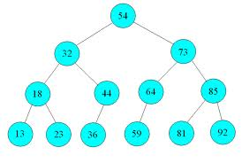
Binary Search Trees or BST
BSTs support the binary search algorithm. To find a specified key one only needs to make a comparison at each node and search left or right just like when performing binary search on a sorted array.

Slide 14
Balanced Binary Trees
A Balanced Binary Search tree is one in which the left and right pointers of each node point to subtrees of roughly the same size (number of nodes are the same to within some fixed constant factor).
A balanced binary search tree can be defined according to a variety of different criteria, e.g., neither of the two subtrees contains more than a fixed fraction of the elements of the entire tree.
Definition: A tree of size N is said to be balanced if and only if its height - the longest path in the tree from the root to a leaf - is proportional to log(N).
A tree is said to be perfectly balanced if it has minimum possible height.

Slide 15
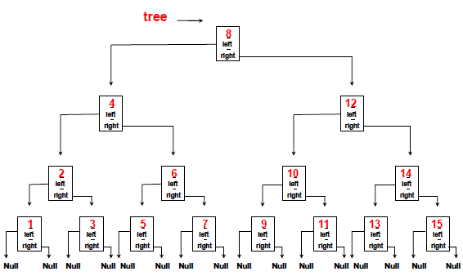
Balanced Binary Trees
Below is a perfectly balanced binary search tree with key fields comprising the numbers 1-15:

Slide 16
Balanced Binary Trees
Examples of balanced binary trees:
- A tree in which subtrees of every node are proportional in size.
- A tree in which subtrees of every node are proportional in height.
- A tree in which subtrees of every node have the same height to within a constant difference.
Note that these conditions must be enforced by some mechanism.

Slide 17
Binary Search Trees or BST
Is the below tree balanced? Maybe. The only way to know is if you are told that it is. Some algorithms for insertion guarantee that when the tree grows to size N the height will be O(log(N)), which implies balance.

Slide 18
Binary Search Trees or BST
Binary search is an example with complexity O(log n). Let's say that the nodes in the bottom level of the tree below represents items in some sorted collection. Binary search is a divide-and-conquer algorithm, and the diagram shows how we will need (at most) 4 comparisons to find the record we are searching for in this 16 item dataset.
Assume we had instead a dataset with 32 elements. Continue the tree below to find that we will now need 5 comparisons to find what we are searching for, as the tree has only grown one level deeper when we multiplied the amount of data. As a results, the complexity of the algorithm can be described as a logarithmic order.

Slide 19
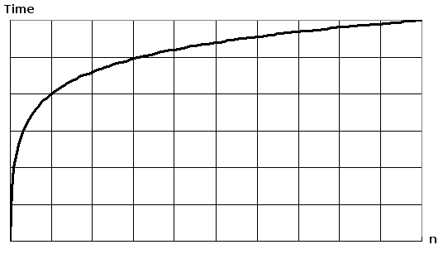
Binary Search Trees or BST
Plotting log(n) will result in a graph where the rise of the curve decelerates as n increases:

Slide 20
Binary Search Trees or BST
The binary search algorithm eliminates from consideration one-half of the data elements in a BST after each comparison
The algorithm compares the search-key to the “root” of the BST and, if it is found it will indicate so
If it is not found the problem is reduced to searching one-half of the remaining “leafs” in the tree
In a worse-case scenario searching a BST of 1024 data elements takes only 10 comparisons
Repeatedly dividing 1024 by 2 yields the values 512, 256, 128, 64, 32, 16, 8, 4, 2 and 1
The number 1024 (2 ¹⁰) is divided by 2 only 10 times to get the value 1
A BST of 1048576 (2 ²⁰) data elements takes a maximum of 20 comparisons to find the search key
A BST of one billion data elements takes a maximum of 29 comparisons to find the required search key
For a one billion data element LINEAR linked list the average amount of comparisons would be 500 million! With a BST it is no more than 30.

Slide 21
Binary Search Trees Definition
An empty/null tree is a valid BST. A node is the root of a valid BST if its left pointer points to a BST in which all nodes have keys that are less than its own, and it has a right pointer that points to a BST in which all nodes have keys that are no less than its own.
Does this sound “recursive”? It should… The recursive structure of BSTs is very important.

Slide 22
BST Algorithms - insert
Assume that we have a new node containing the value m. Let top be a reference to the top of the tree.
REPEAT:
If top is an empty tree, then set it equal to the node containing m. Return.
If top is not empty, then compare m to the key stored in the root. If m is less than the key in the root, then set top equal to the left subtree; otherwise set top equal to the right subtree.

Slide 23
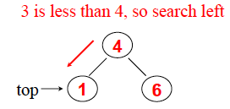
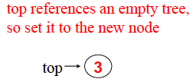
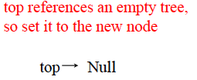
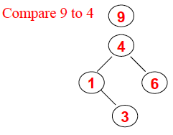
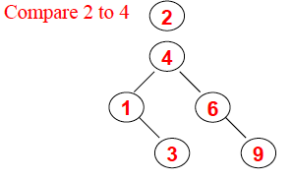
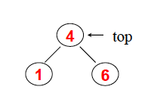
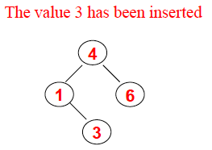
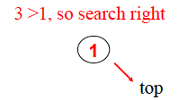

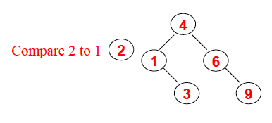
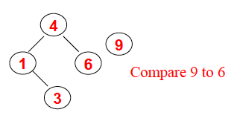
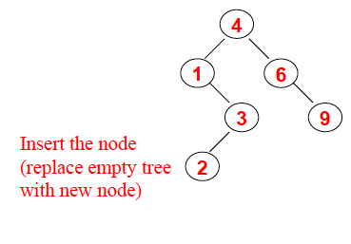
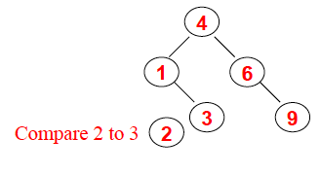
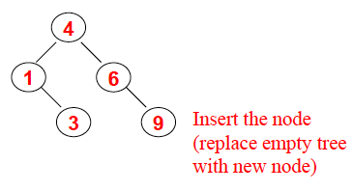
BST Algorithms - insert
Consider the insertion of the number 3 into the below tree:
Let’s add 3, then 9 then 2 to the following tree

Slide 24
BST Algorithms - SEARCH
The following algorithm searches for a node with the value m in a binary search tree.
Let top be a reference to the top of the tree
REPEAT:
If top is an empty tree, then return a null reference indicate that m is not in the tree.
If top is not empty, then compare m to the key stored in the root. If m is less than the key in the root, then set top equal to the left subtree
If m is great than the key in the root, then set top equal to the right subtree
Otherwise return top

Slide 25
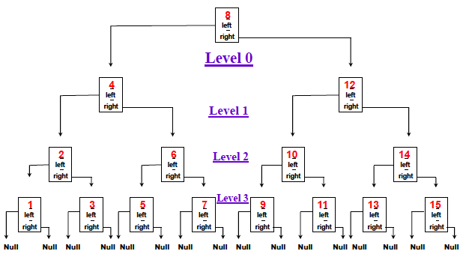
BST Algorithms - Searching
Note that the search and insertion algorithms are almost identical
They both consist of a traversal of the BST to find the location of a value
Both algorithms traverse a single path through the tree, so their complexity is determined by the longest possible path in the tree
The length of the longest path in a tree defines the height of the tree – also defined as the number of levels in the tree indexing from zero:

Slide 26
BALANCED Binary Search Trees
A perfectly balanced BST can be constructed directly from a dataset that is in sorted order in O(N) time: it’s linear
If an array is empty, then return Otherwise create a node containing the value in the middle element Set the left point of the node to the BST formed from the left subarray and set the right pointer to the BST formed from the right subarray

Slide 27
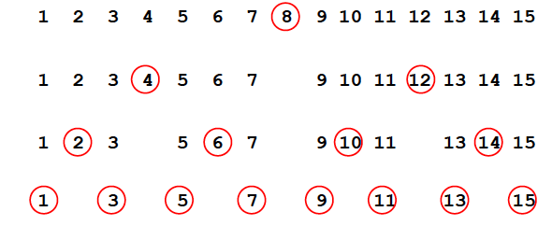
BALANCED Binary Search Trees
The following shows the construction of a perfectly balanced BST from a sorted array:

Slide 28
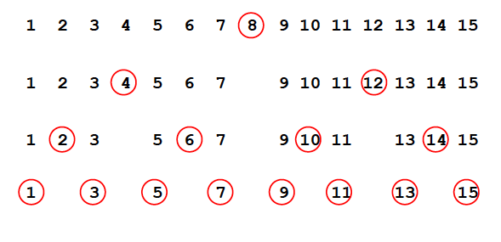
BALANCED Binary Search Trees
Note that the search of the BST examines the same keys as the binary search of the original sorted array:

Slide 29
Binary Search and BSTs
Sorted arrays and balanced BSTs can be viewed as different data structures for support of the binary search algorithm
The sorted array data structure offers some computational savings by avoiding the overhead associated with left and right pointers, but BSTs have the advantage of being able to support dynamic insertions
The simple insertion algorithm considered thus far does not guarantee that the resulting BST is balanced
There are more sophisticated methods that permit insertions and deletions to be performed in such a way that the BST remains balanced
The main practical utility of the simple insertion algorithm we discussed is that it can be expected to produce a balanced BST for randomly-ordered data

Slide 30
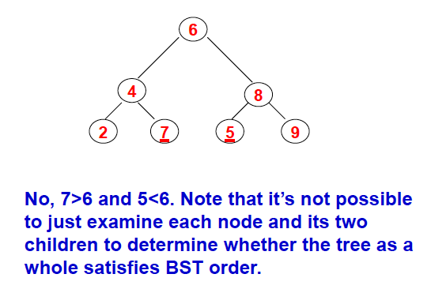
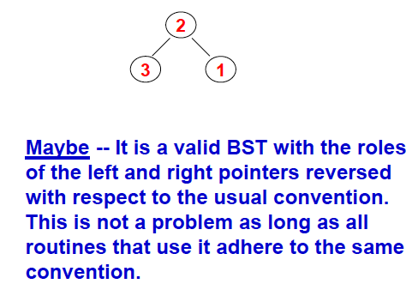
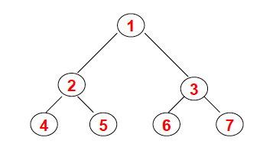
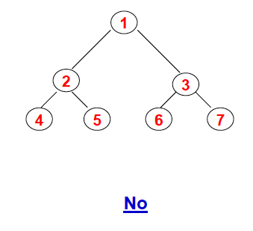
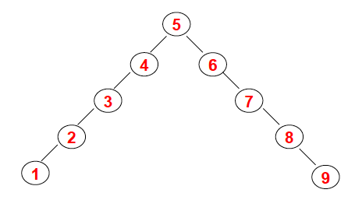
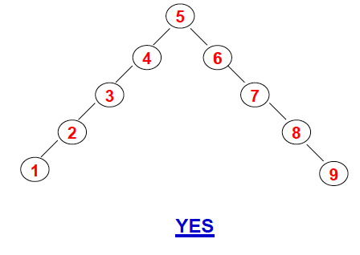
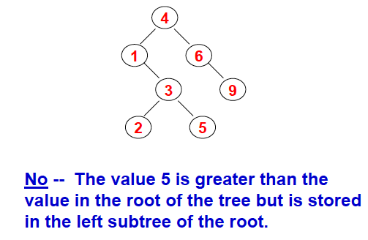
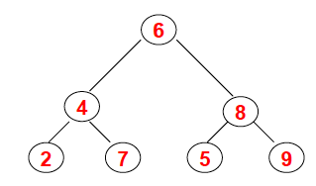
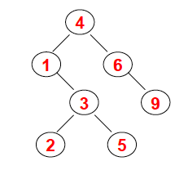
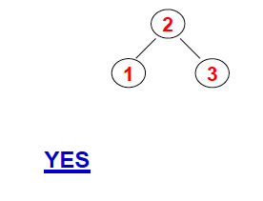
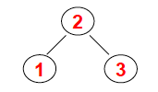
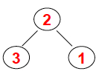
Recognizing BSTs
Is the following a valid BST?

Slide 31
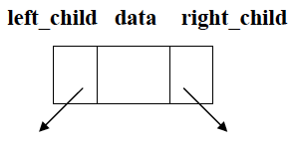
Implementation of BST
Remember – most of the functions – even the definition of BST’s –is RECURSIVE A binary tree is either - empty, or - A node (called root) together with two binary trees (called left subtree and the right subtree of the root)
A struct struct tree_node{ int data; struct tree_node *left_child; struct tree_node *right_child; };

Slide 32
Preorder Traversal of a Binary Tree
In a preorder traversal, we first visit the root node
If there is a left child we visit the left subtree (all the nodes) in pre-order fashion starting with that left child
This function might seem simplistic, but the real power lies in the recursive formulation. In fact, there is *double* recursion. The real job is done on the run-time stack. This simplifies the code but puts a heavy burden on the system. void preorder(struct tree_node * p) { if (p !=NULL) { printf(“%d\n”, p->data); preorder(p->left_child); preorder(p->right_child); } }

Slide 33
Finding the Sum of the Values of a BST
To find the sum, add to the value of the current node, the sum of values of all nodes of the left subtree and the sum of values of all nodes in the right subtree.
int sum(struct tree_node *p) { if ( p!= NULL) return(p->data + sum(p->left_child) + sum(p->right_child));
else return 0; }

Slide 34
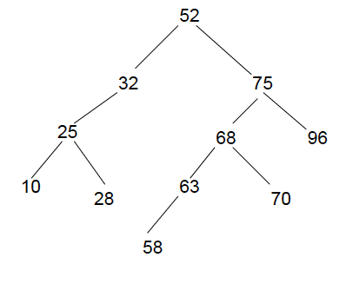
Binary Search and BSTs
As we know, if the values in nodes of a binary tree are arranged in a specific order with all elements smaller than the root stored in the left subtree and all elements greater than the root stored in the right subtree it represents a sorted list.
The search complexity reduces considerably. The binary search is only as long as the height of the tree which is *much* less than the total number of nodes. Another example:
A PREORDER TRAVERSAL (we discussed earlier) will yield the following sequence: 52, 32, 25, 10, 28, 75, 68, 63, 58, 70, 96
AN INORDER TRAVERSAL will yield the following sequence: 10, 25, 28, 32, 52, 58, 63, 68, 70, 75, 96
Notice something here???

Slide 35
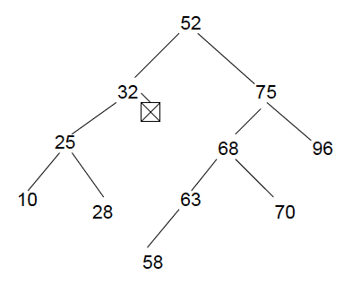
Inserting a node in a BST
Inserting a node in a BST requires that it be done so that the overall BST structure is still maintained (greater than, less than structure)
Inserting a new node into a BST *always* occurs at a NULL pointer. There is *never* a case when existing nodes need to be rearranged to accommodate the new node!
As an example, consider inserting the new value 43 into the BST above. Where is the new node supposed to go? To the NULL pointer where it should be placed which is the right pointer of 32.

Slide 36
Inserting a node in a BST
The code struct treenode* insert( int d , struct treenode * p) { //Inserting the value in a new node if( p== null) { p = (struct treenode*)(malloc(sizeof(struct treenode))); p->data = d; p->left = NULL; p->right = NULL; } //Inserting a value less than the root value, move left else if(d < p->data) p->left = insert( d, p->left); //Inserting a value greater than the root value, move right else if(d > p->data) p->right = insert( d, p->right ); return p; }

Slide 37
Breadth-First Tree Traversal
So far we have discussed traversing a tree in certain order
Preorder
Inorder
Both of these types of “traversing” are classified as “depth first” traversal because they because they try to go “deeper” first. They traverse all the way down one side and work their way back.
There are many other ways to traverse a tree. One of these is the “Breadth-First” traversal
It is a “level by level” traversal of a tree from left to right instead of top to bottom.
We explore the full width of the tree at any given level before going deeper

Slide 38
Breadth-First Tree Traversal
The first question would be “Why would you ever traverse a tree from left to right then top to bottom?”.
Answer: some applications may require it
For example:
Tree of leadership (authority structure)
It is meant to represent who is in charge of an organization (company, university, military) and who reports to who
People of the same level of authority are at the same level in the tree
Breadth-First traversal of a graph
Very common algorithm and one you will learn in CS3050. Along with the breadth-first as well (in more detail and options)

Slide 39

Breadth-First Tree Traversal

Slide 40
Breadth-First Tree Traversal (continued)
There are a number of ways to do this
You can use a queue() or stack() function to assist with this
One way is to use a priority queue() and reload the nodes by level (priority)
You have to continually keep track of the level of the node based on the traversal
You could combine a preorder traversal and a queue to do this

